Slide 1
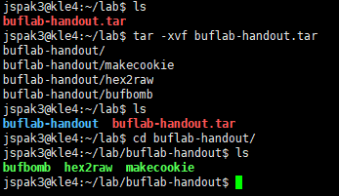
BufBomb Level 0 : Candle
1. Download buflab-handout.tar from LMS
2. Unzip it with tar –xvf command
3. Once you unzip it, you can see three files : - Bufbomb, hex2raw, and makecookie
See README.pdf for more info of the files.

Slide 2
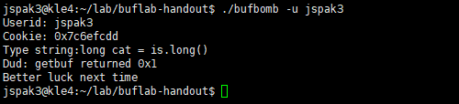
How to Execute BufBomb
The target file is bufbomb, it can be executed by using option –u (your student ID).
Your task is to deactivate your bufbomb by putting a correct input.

Slide 3
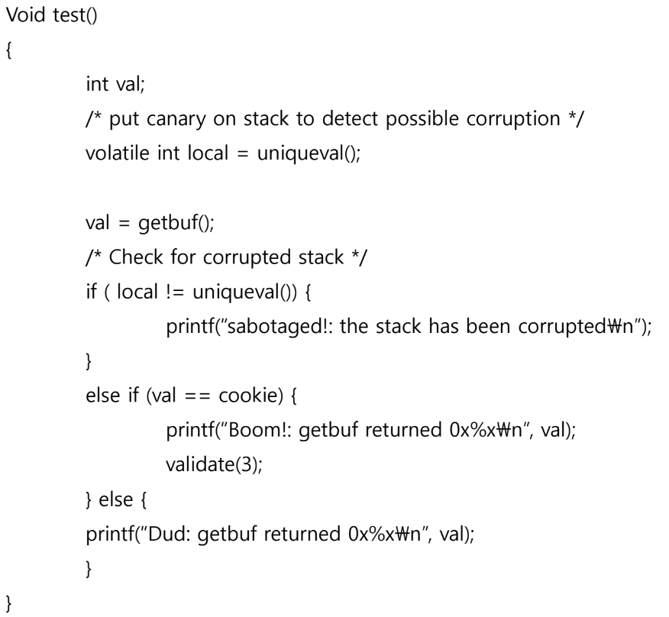
Practice Description
Get a BUFBOMB by executing the code of smoke()
using getbuf() – with its return statement, instead of letting the program return to test()
If you execute code of smoke by causing buffer overflow within getbuf(), the program would detects a stack corruption.

Slide 4
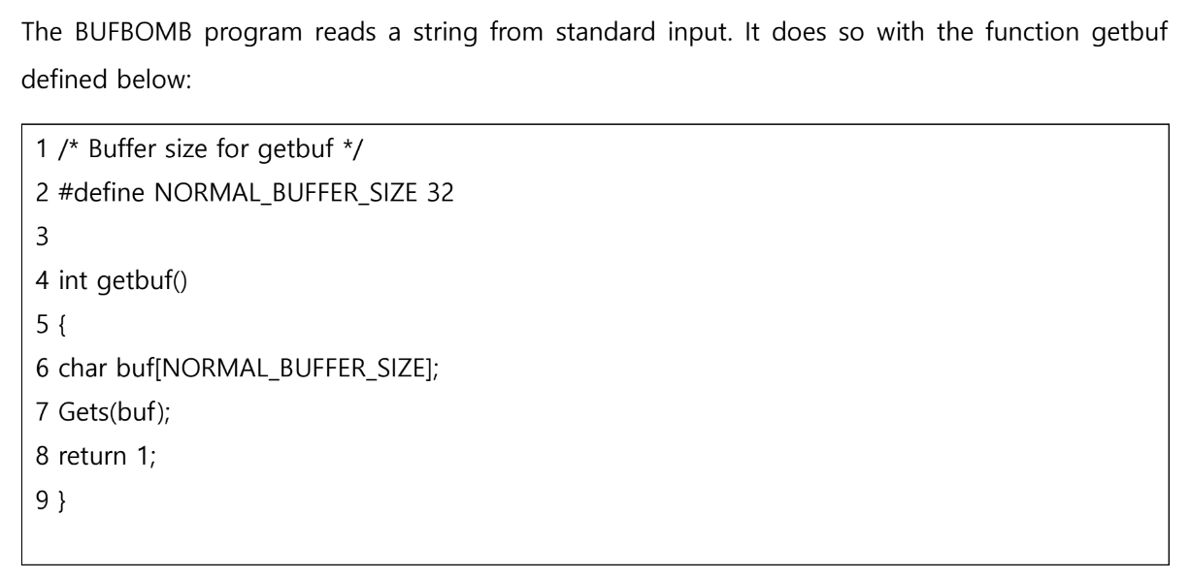
Getbuf()
As you may know, the Gets() function can be overflowed.
Your input is the local value buf[NORMAL_BUFFER_SIZE].

Slide 5
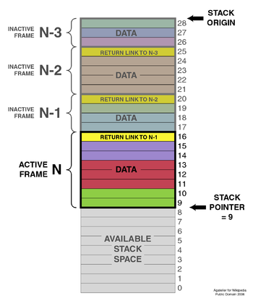
RET Operation
What we will do : abuse RET operation(return address)
If a function executes RET, program will jump on
return address RBP+0x04 (RETURN LINK TO N-1).
If smoke() function’s address is placed on this segment,
the program will execute the smoke() function!
RBP of N-1
RBP of N
RSP of N

Slide 6
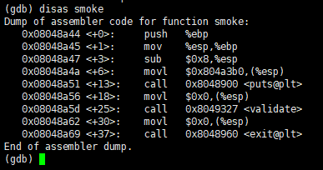
How to Get Smoke()’ Address
0x08048a44 is the start address of smoke().
Intel CPU uses Little Endian.
Thus, we have to put “44 8a 04 08”.

Slide 7
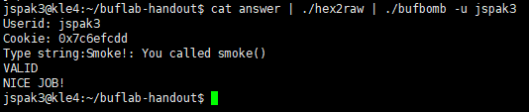
Result
See REDME.pdf for how to use hex2raw binary for bufbomb

